Slide 1


Vidyavardhaka College of Engineering, Mysuru
Autonomous Institute, Affiliated to VTU
Accredited by NBA | NAAC with ‘A’ Grade
Module 3 : Syntax Analysis II

Slide 2
Introduction to LR parsing
LR(k) parsing is another technique to perform bottom- up parsing.
LR(k) will parse the input string by applying rightmost derivation in the reverse.
LR(k), where
L stands for Left to right scanning of the input.
R stands for rightmost derivation in the reverse.
K stands for no of input symbols of lookahead that are used in making parsing decisions.

Slide 3
Why LR parsers?
LR parsers are table driven, much like non recursive LL parsers.
A grammar for which we can construct a parsing table using one of the LR parsing Method
SLR ( simple LR)
CLR ( Canonical LR)
LALR (Lookahead LR)
For a grammar to be LR it is sufficient that a left-to-right shift reduce parsers be able to recognize handles of right sentential forms when they appears on the top of the stack.

Slide 4
LR parsing Advantages
LR parsers can be constructed to recognize virtually all programming language constructs for which context free grammars can be written.
LR parsing method is the most generally non- backtracking shift reduce parsing method.
LR parsing method can detect a syntactic error as soon as it starts left to right scan of input.
LR parsers can describe more languages than LL grammars.

Slide 5
LR parsing Disadvantages
The main drawback is they consumes too much time to construct by hand for a typical programming language grammars.
This disadvantages can be eliminated using LR parser generators such as YACC.

Slide 6
Types of LR Parsers
Simple LR Parsers(SLR):
Easy to implement
But , sometimes it may fail to produce the parsing table for certain grammars.
2. Canonical LR parsers: (CLR)
More powerful and works on very large class of grammars.
Very expensive to implement.
3. Look-Ahead LR parsers: (LALR)
Intermediate between SLR and CLR.
Implemented for most of the grammars.

Slide 7
Items and the LR(0) Automaton
An LR(0) item or item of a grammar G is a production of G with a dot(.) on the right hand side of production.
example:
Consider the production A->BCD
The various items that can be obtained using this production are:
A -> .BCD
A->B.CD
A->BC.D
A->BCD.
Note: A->€ (epsilon) then item is A-> .
The all above items are called Canonical LR(0) collections , we can construct a DFA.

Slide 8
Canonical LR(0)
The construction of a Canonical LR(0) collection of items for a grammar can be obtained using:
An augmented grammar
Closure function
GOTO function
Items Function.

Slide 9
Augmented grammar
Let G = ( V, T, S, P) be a grammar an augmented G’ for the grammar G is defined as G’ = (V’, T, S’,P’).
We are adding a new production for the start symbol i.e., S’ -> S
The main purpose of the new starting production is to indicate to the parser when it should stop parsing and announce acceptance of the input.
Example : Augmented grammar
E -> E + T | T E’ -> E
T -> T * F | F E -> E + T | T
F -> ( E ) | id T -> T * F | F
F -> ( E ) | id

Slide 10
Closure of Item sets:
If I is a set of items for a grammar G then CLOSURE(I) is constructed using the following two rules.
Rule 1: Initially, add every item in I to CLOSURE(I).
Rule 2: If A -> α .B β is in CLOSURE (I) and B -> γ is a production and B->. Γ is not there in CLOSURE(I) , then add B-> . Γ to CLOSURE(I).
apply rule 2 repeatedly until no more new items are added to CLOSURE(I).
Consider an augmented grammar then the closure items set is written as
E’ -> . E
E -> . E + T
E -> . T
T -> . T * F
T -> . F
F -> . ( E )
F -> .id

Slide 11
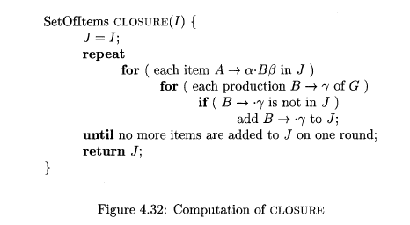

Slide 12
GOTO Function
The GOTO(I , X) is a function which accepts set of items I as the first arguments and X which is a grammar symbol which can be either terminal or a non-terminal as the second arguments.
It is defined as ,
if A -> α . X β in I
GOTO ( I , X ) = CLOSURE ( A - > α X . β )

Slide 13
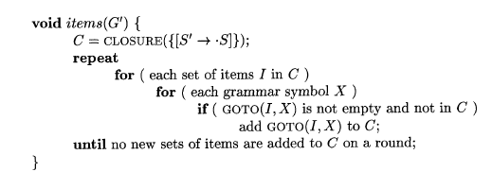
Computation of the canonical collection of sets of LR(0) items

Slide 14
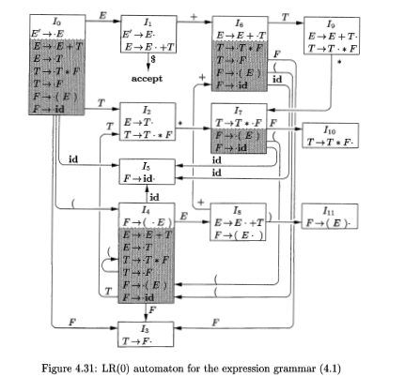

Slide 15
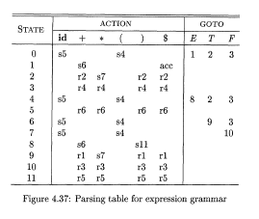

Slide 16
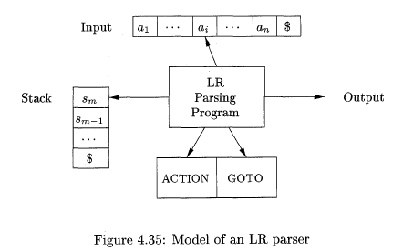
LR Parsing Algorithm
It consists of an input , output , a stack , a driver program and a parsing table has 2 parts (ACTION and GOTO).
The parsing program reads a characters from an input buffer one at a time, where a shift – reduce parsers would shift a symbol , an LR parsers shift a state.

Slide 17
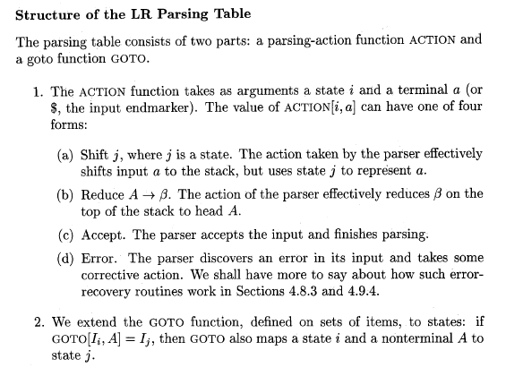

Slide 18
Chapter 5 Syntax-Directed Translation

Slide 19
Introduction
The main goal of the semantic analysis is to check the correctness of program and enable proper execution.
Semantic analysis is the third phase of the compiler which acts as an interface between syntax analysis phase and Intermediate code generation phase.
It accepts the parse tree from the syntax analysis phase and adds the semantic information to the parse tree and performs certain checks based on this information.

Slide 20
The semantics of a languages can be described using two notations namely
Syntax Directed Definition (SDD)
Syntax Directed Translations (SDT)
Note: Consider the production E -> E + T, to distinguish E on LHS and E on RHS we will use E1 on RHS of production then ,
E -> E1 + T parse Tree
E
E1
T
+

Slide 21
Syntax Directed Translation
The most general approach to syntax directed translation is to construct a parse tree or a syntax tree and then to compute the values of a attributes at the node of the tree by visiting the nodes of the tree.
Two types of SDT
L – attributed translations-- ( L stands for Left to right)
-- It consists of both synthesized and inherited attributes
S – attributed translations --- ( S for synthesized )
-- It consists of synthesized attributes
-- It can be performed easily with bottom-up parse.

Slide 22
Semantic Rules
The Rule that describes how to compute the attribute values of the attributes associated with a grammar symbols using attribute values of other symbols is called semantic rule.
Example :
E.val = E1.val + T.val

Slide 23
Syntax Directed Definition (SDD)
A syntax Directed definition (SDD) is a context free grammar with attributes and semantic rules.
The attributes are associated with grammar symbols and semantic rules are associated with Productions.
Consider the SDD for the production
E -> E1 + T
Production | Semantic Rules
E -> E1 + T | E.val = E1.val + T.val

Slide 24
SDD
An attribute is a property of a programming language construct.
Attributes are always associated with a grammar symbols.
If X is a grammar symbol and ‘α’ is a attribute , then X.α is a value of attribute ‘α’ at a particular node X in the parse tree.
Examples:
val = attribute
E = Non-terminal, then node E is represented as E.val
lexval = attribute
digit = Terminal, the node digit represented as digit.lexval

Slide 25
Attributes
Typical Examples of an attributes are
Data types associated with variables such as int, float, char.
Value of an expression e.g. E.val
The location of a variable in memory
The object code of a function or procedure.
The number of significant digits in a number and so on.

Slide 26
Types
The attribute value for a node in the parse tree may depends on information from its children nodes or its sibling nodes or parent nodes.
There are 2 types of attributes for the non terminals are
Synthesized attribute ( S-attributes )
Inherited attribute (I – attribute)

Slide 27
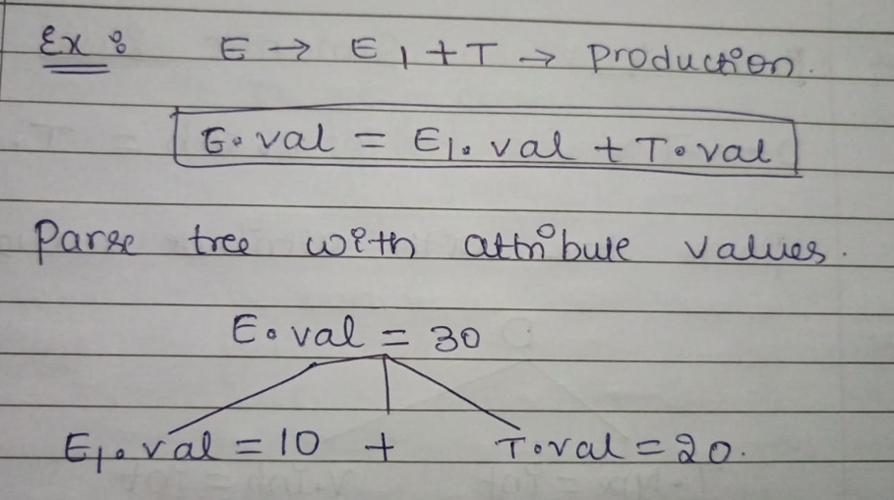
Synthesized attributes
A synthesized attribute: the attribute value of a non-terminal A derived from the attribute values of its children or itself.
The attribute values of synthesized attributes are passed up from children to the parent node in bottom-up manner.

Slide 28
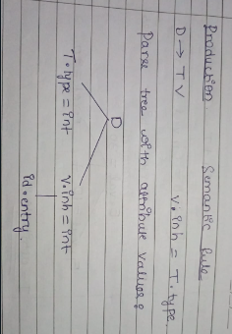
Inherited- attribute
An inherited attribute: the attribute value of a non-terminal A derived from the attribute values of its siblings or from its parents or itself.
The attribute values of inherited attributes are passed from siblings or from parent to childreb in top-down manner.
Example : D -> T V
Single declaration :- D = int Sum
Terminals can have synthesized attributes but not inherited attributes.
Attributes for a terminals have lexical values that are supplied by the lexical analyzers.

Slide 29
Annotated Parse tree
A parse tree showing the attribute values of each node is called annotated parse tree.
The terminals in annotated parse tree can have only synthesized attribute values and are obtained directly from the lexical analyzer.

Slide 30
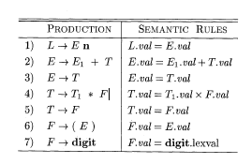
1. Write the SDD for a simple Desk calculator and show annotated parse tree for expression 3 * 5 + 4 n

Slide 31
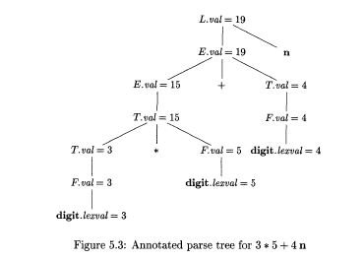

Slide 32
2. Write the SDD for a simple Desk calculator and show annotated parse tree for expression( 3 + 4) * ( 5 + 6) n
Given grammar is
L -> En
E-> E + T | E – T | T
T -> T * F | T / F | F
F -> ( E ) | digit

Slide 33
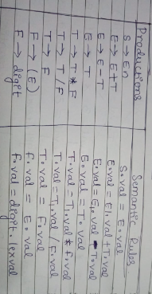

Slide 34
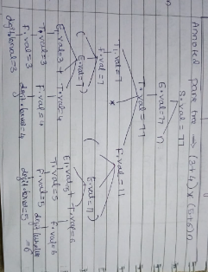

Slide 35
Evaluating an SDD at the nodes of a Parse Tree
We can easily obtain an SDD using the following steps.
Step 1 : Construct the parse tree
Step 2 : Use the rules to evaluate attributes of all the nodes of the parse tree.
Step 3: Obtain the attribute values for each non-terminals and write the semantic rules for each production. When complete annotated parse tree is ready, we will have the complete SDD.

Slide 36

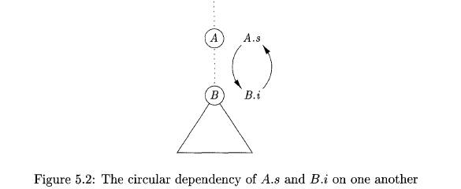
Circular dependency
If the attribute value of a parent node depends on the attribute value of a child node and vice-versa, then we say there exists a circular dependency between the child node and parent node.
In this situation, it is not possible to evaluate the attribute of either parent node or the child node since one value depends on another value.

Slide 37
Why we have to evaluate inherited attributes
Consider the following grammar
T -> T * F | F
F -> digit
Using the above productions, we can generate an un-parenthesized expression consisting of only * operator.
The above grammar has left -recursion and it is suitable for bottom-up parser such as LR parsers.
Consider annotated parse tree for evaluating the expression 3 * 5 is shown below.

Slide 38
Example : Obtain SDD for the following grammar using Top-down approach for the expression 3 * 3
Grammar : T -> T * F | F
F -> digit
Solution:
The given grammar has left recursion and hence it is not suitable for top-down parsers.
After removing left recursion , the grammar is written as
T - > F T’
T’ -> * F T’ | ε

Slide 39
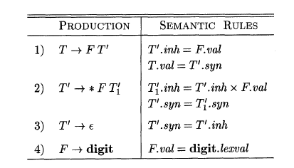
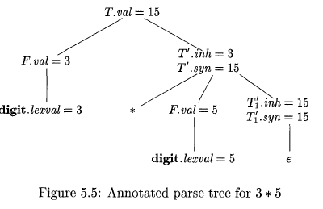

Slide 40
Evaluation Orders for SDD
Dependency Graphs
Ordering the evaluation of attributes
S-attributed definition
L-attributed definition
Semantic rules with controlled side effects.

Slide 41
Evaluation orders for SDD’s
The evaluation order to find attribute values in a parse tree using semantic rules can be easily obtained with the help of dependency graph.
While annotated parse tree shows the values of attributes, a dependency graph helps us to determine how those values can be computed.

Slide 42

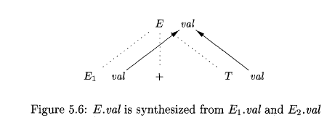
Dependency Graphs
A dependency graph depicts the flow of information among the attribute instances in a particular parse tree;
An edge from one attribute instance to another means that the value of the first is needed to compute the second.
Example:

Slide 43
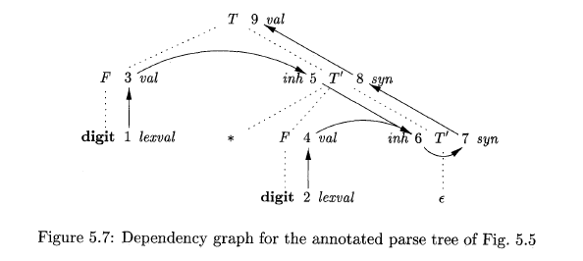
Example

Slide 44
Ordering the evaluation of attributes
The dependency graph characterize the possible orders in which we can evaluate the attributes at the various nodes of a parse tree.
Ordering embeds a directed graph into a liner order and is called a topological sort of the graph.

Slide 45
S-Attributed Definition:
Given an SDD, it is very difficult to tell whether there exists a cycle in the dependency graph corresponding a parse tree.
But, in practice, translations can be implemented using classes of SDD’s that will guarantee an evaluation order, since they do not permit dependency graphs with cycles.
The 2 classes of SDD’s that guarantee an evaluation order are:
S-attributed definition
L-attributed definition

Slide 46
S-Attributed definition: An SDD is S-attributed if every attribute is synthesized.
In an S-attributed SDD, each semantic rule computes the attribute value of a non terminal that occurs on LHS of the production that represents head of the production with the help of the attribute values of non terminals on the right hand side of the production that represent body of the production.

Slide 47
L-attributed definition:
the idea behind this class is that, between the attributes associated with the production body, dependency graph it just can go from left to right but not from right to left (hence L-attributed).
More-precisely, each attribute must be either:
Synthesized, or
Inherited.

Slide 48
Chapter-6 Intermediate-Code Generator

Slide 49
Variants of Syntax Trees:
Nodes in a syntax tree represent constructs in the source program; the children of a node represent the meaningful components of a construct.
A directed acyclic graph(called a DAG) for an expression identifies the common ‘subexpressions’ of the expression.
DAG’s can be constructed by using the same techniques that construct syntax trees.

Slide 50
Directed Acyclic Graphs for Expressions
Like the syntax tree for an expression, an DAG has leaves corresponding to atomic of parents and interior nodes corresponding to operators.
The difference is that a node N in a DAG has more than one parent if N represents a common subexpression; in a syntax tree, the tree for a common sub expression would be replicated as many times as the expression appears in the original expression.
Thus, a DAG not only represents expressions more succinctly, it gives the compiler important clues regarding the generation of efficient code to evaluate the expressions.

Slide 51
The SDD Can construct either syntax trees or DAG’s.
it was used to construct syntax trees, where functions ‘Leaf’ and ‘Node’ created a fresh node each time they were called.
It will construct a DAG if, before creating a new node, these functions first check whether an identical node already exists.
If a previously created identical node exists, the existing node is returned.
For instance, before constructing a new node, Node(op, left, right) we check whether there is already a node with label op, and children ‘left’ and ‘right’, in that order.
If so, ‘Node’ returns the existing node; otherwise, it creates a new node.

Slide 52
Three Address Code:
It is an intermediate code used by the optimising compilers.
In three address code, the given expression is broken down into several separate instructions.
These instructions are easily translated into assembly language.
Each three address code has atmost 3 operands.
It is a combination of assignment and a binary operator.
In three address code, there is atmost one operator on the right hand side of the instruction.
Example: x+y*z

Slide 53
Different Representations of Three Address Code:
Three address code can be represented in various forms viz. quadruples, triples and indirect triples.
Quadruples: It will be constructed by consulting every production during the construction of three address code. It consists of 4 fields namely, op, arg1, arg2, and result.
Triples: It will be constructed by consulting quadruple representation and we have to write references. It consists of 3 fields namely, op, arg1, and arg2.

Slide 54
Indirect Triples: It makes use of pointers to the listing of all references to the competitions which is made separately and stored. it requires less space than triplet representation.

